Slide 1


SWP391: FINAL PROJECT PRESENTATION
Agricultural Warehouse Management
Mentor:
LinhNDM3

Slide 2




Team member
Đào Huy Hoàng - HE181245
Hồ Văn Thành - HE186618
Nguyễn Xuân Chiến - HE181121
Đào Nhật Quang - HE186891
Nguyễn Hoàng Anh - HE186218

Slide 3



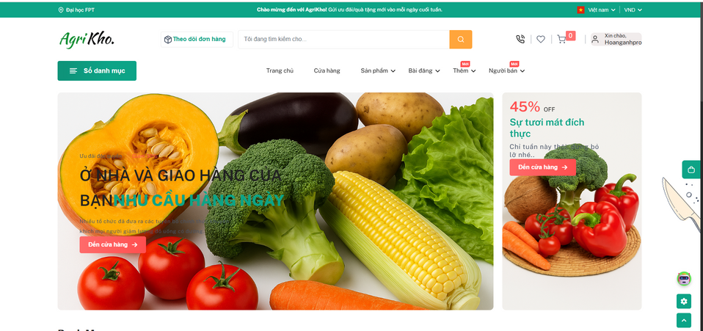





PRODUCT INTRODUCTION & SCOPE
INTRODUCTION:
The "AgriculWarehousemanage" system was built to meet people's increasing demand for online shopping

Slide 4
PRODUCT INTRODUCTION & SCOPE
Scope:
1. Administrator
Manages users, products, suppliers, orders, pricing, promotions, and system settings. Approves account registrations and confirms orders.
2. Customer
Wholesale buyers who place orders, use vouchers, view purchase history, and contact sellers for better deals.
3. Warehouse Manager
Handles inventory checks, stock updates, warehouse issues, stock-in/out, suppliers, and batch management.
4. Seller
Manages product info and confirms orders to allow warehouse processing. Tracks order status.
5. Blogger
Creates and manages blog posts. Admins moderate content and control permissions.
6. Delivery Staff
Delivers products and updates order status (e.g., Out for Delivery, Delivered, Failed).

Slide 5













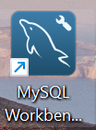





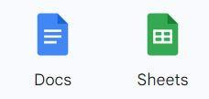





PROJECT COMMUNICATION
Technologies
Meeting
Task assignment:
Tool

Slide 6

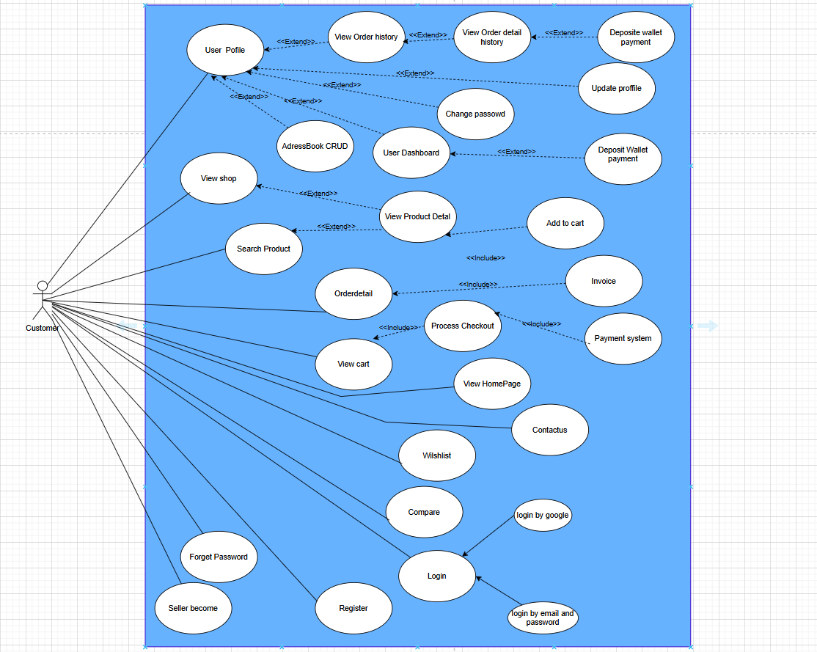

Product Requirements Use Case Diagrams
UC Diagram for Customer

Slide 7
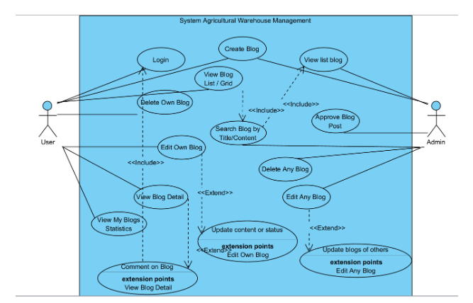
Product Requirements Use Case Diagrams
UC Diagram for Customer blog

Slide 8
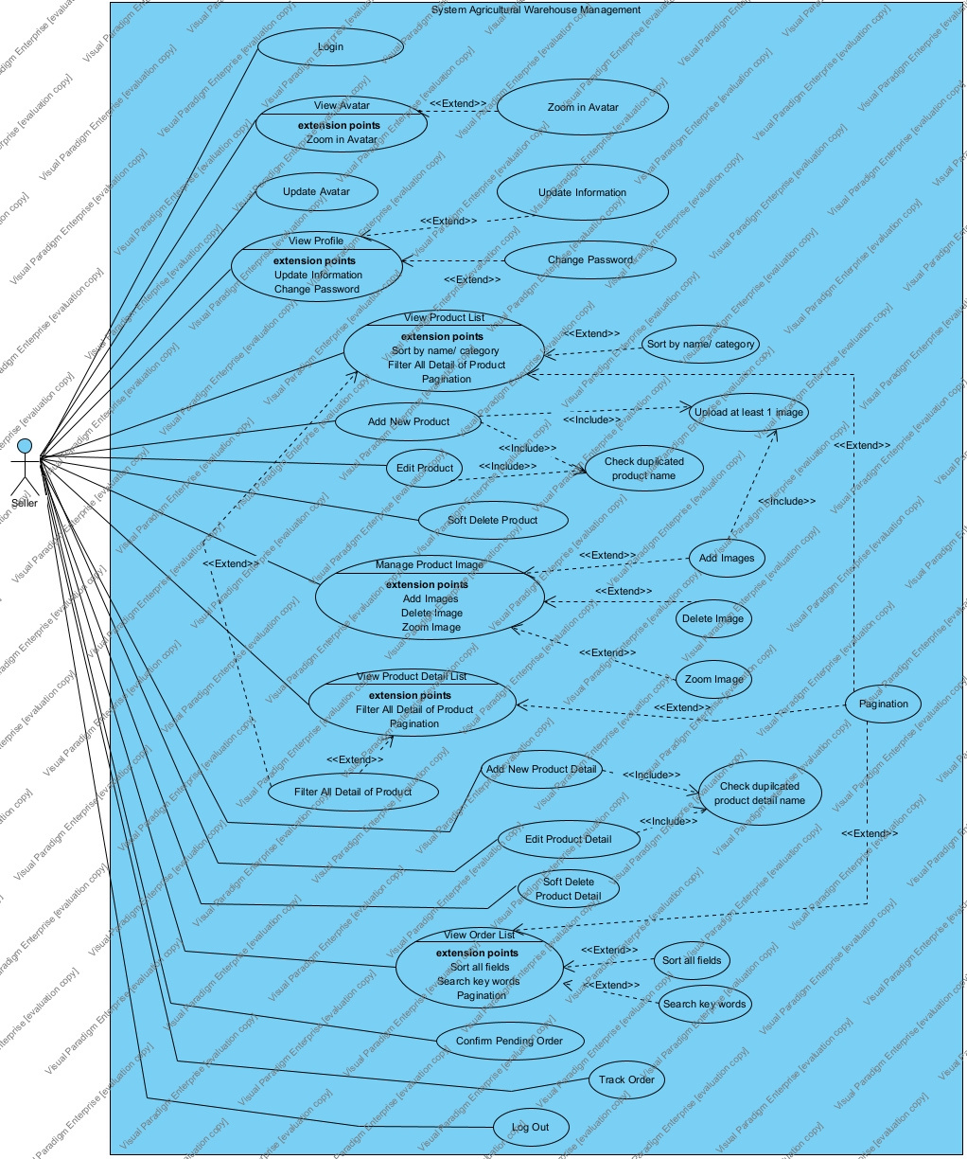
Product Requirements Use Case Diagrams
UC Diagram for Seller

Slide 9
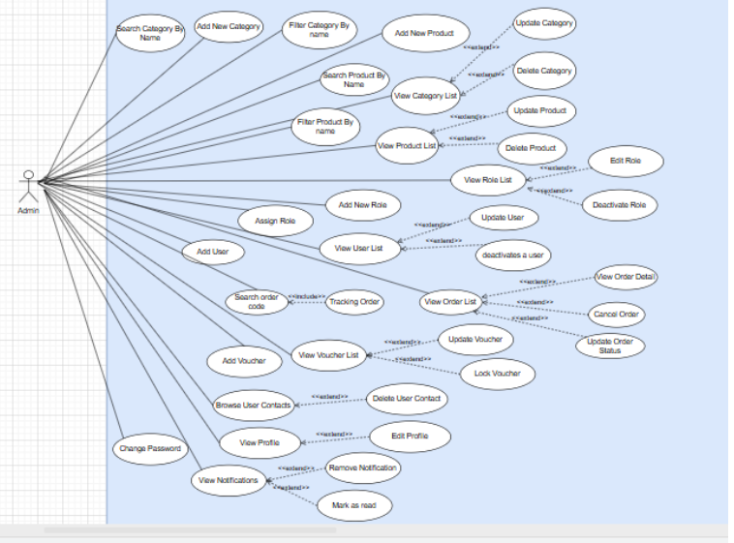
Product Requirements Use Case Diagrams
UC Diagram for admin

Slide 10
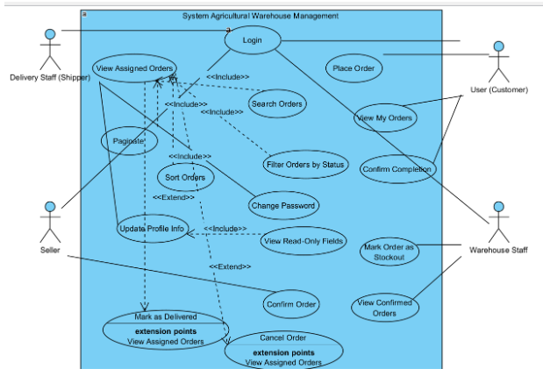
Product Requirements Use Case Diagrams
UC Diagram for delivery

Slide 11
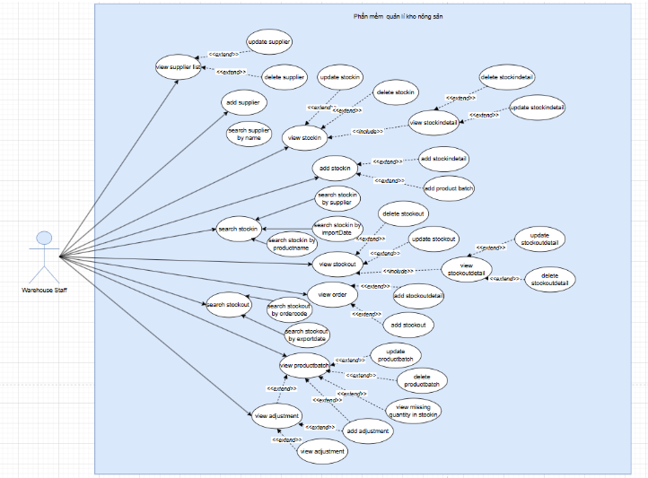

Product Requirements Use Case Diagrams
Requirements Use Case Diagrams
UC Diagram for warehouse manager

Slide 12

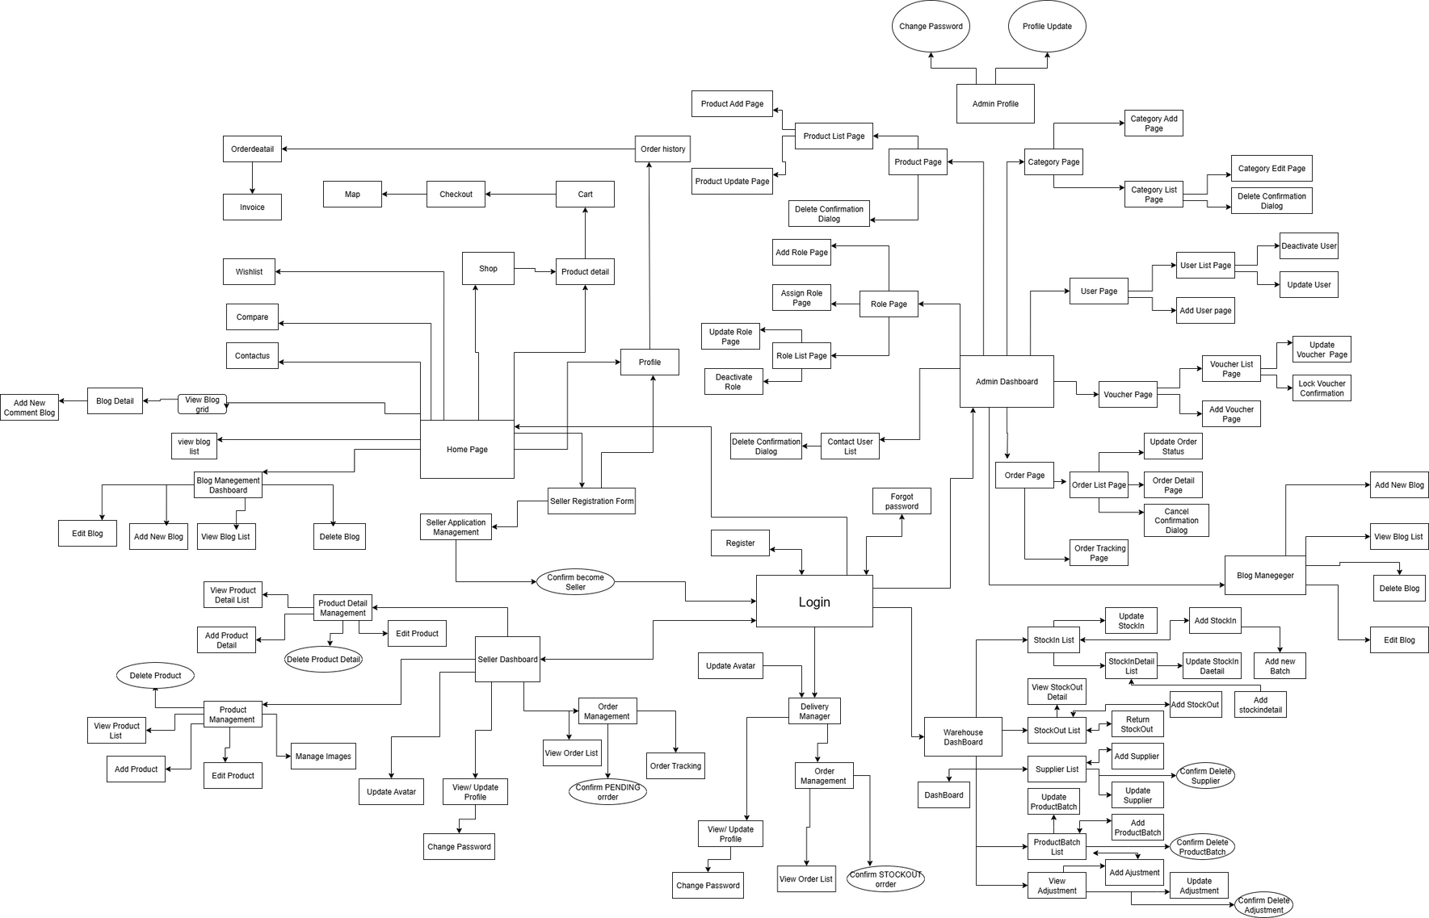
Product Requirements Screen ﬂow
Screens Flow

Slide 13
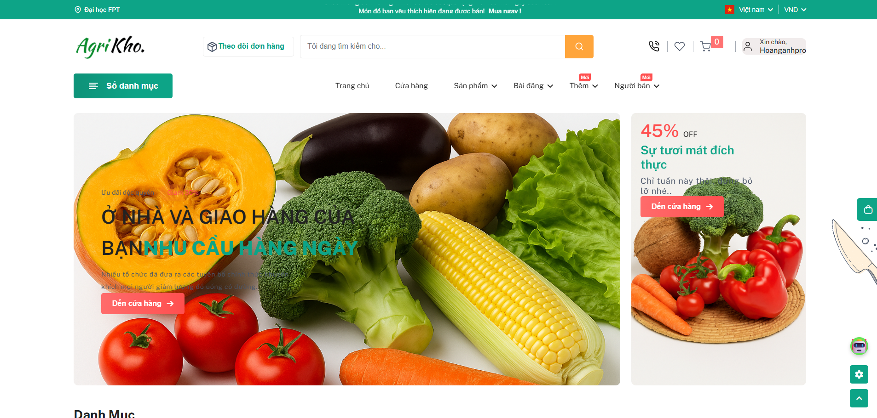
Product Requirements Main Screen UI Design(Guest/Customer)

Slide 14
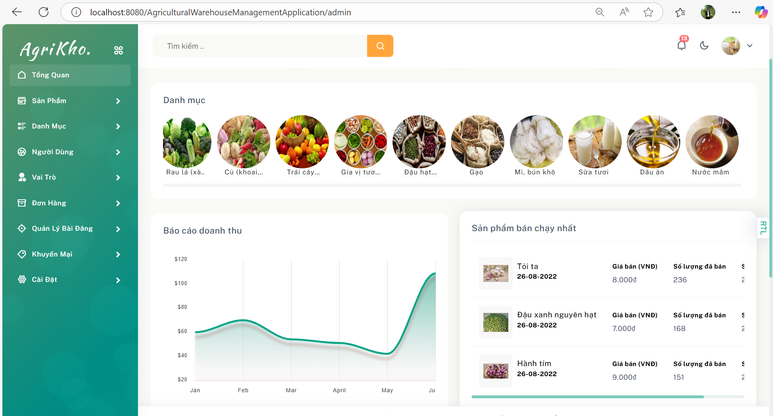
Product Requirements Main Screen UI Design (admin)

Slide 15
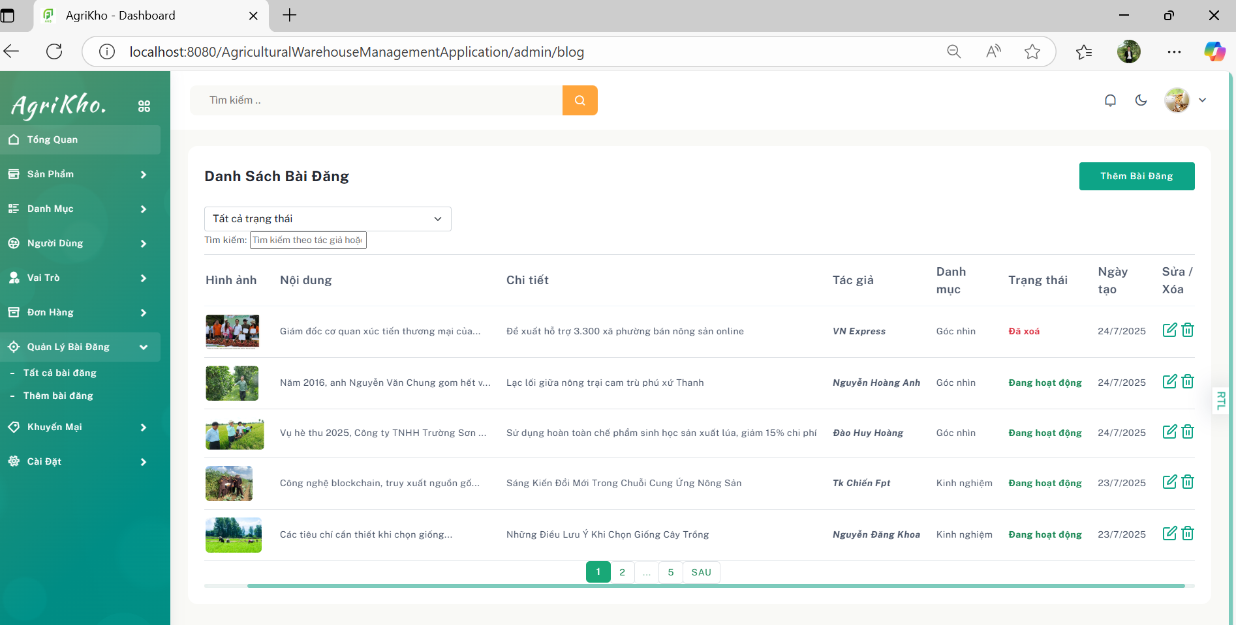
Product Requirements Main Screen UI Design (admin blog)

Slide 16
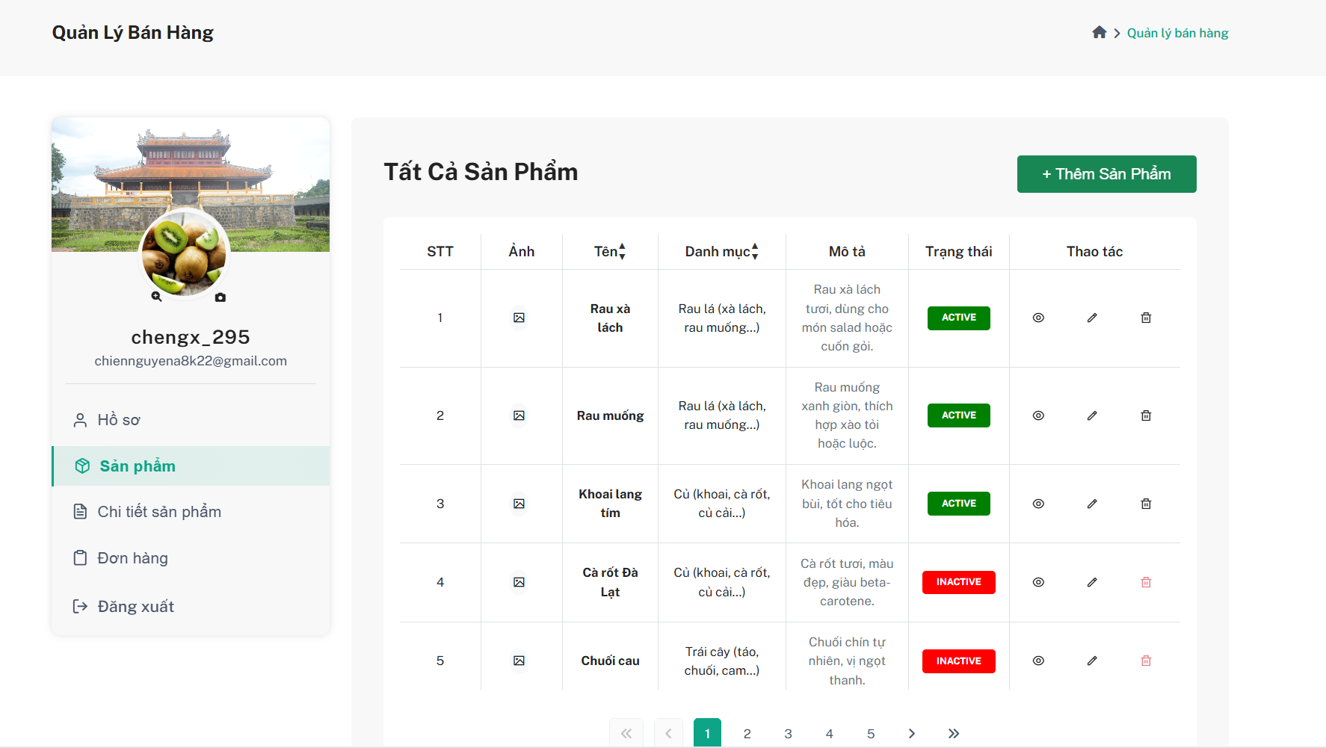
Product Requirements Main Screen UI Design(Sale)

Slide 17
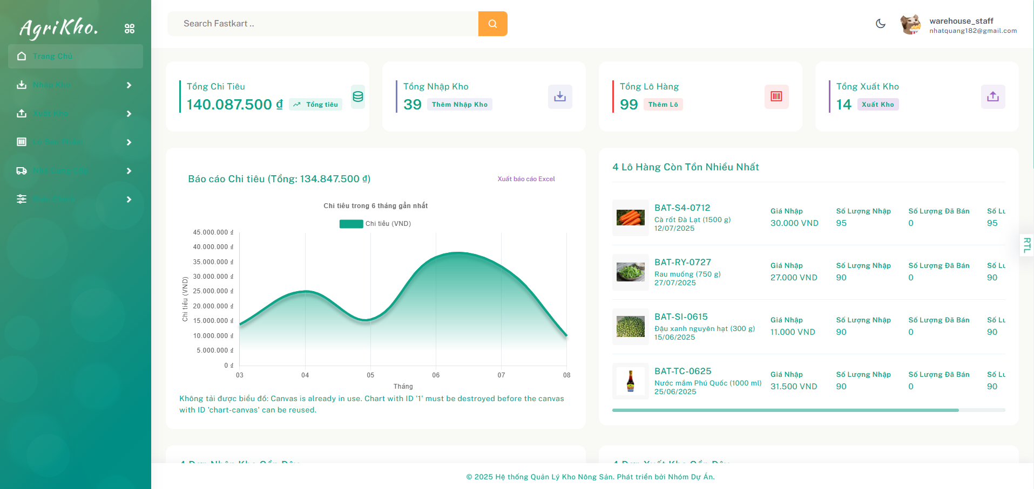
Product Requirements Main Screen UI Design (warehouse)

Slide 18
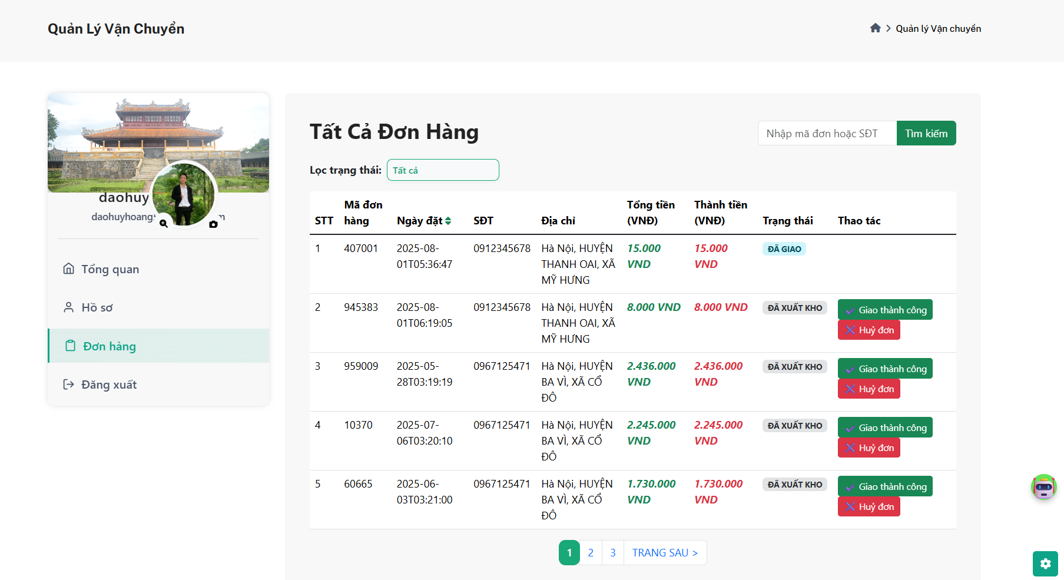
Product Requirements Main Screen UI Design (delivery)

Slide 19
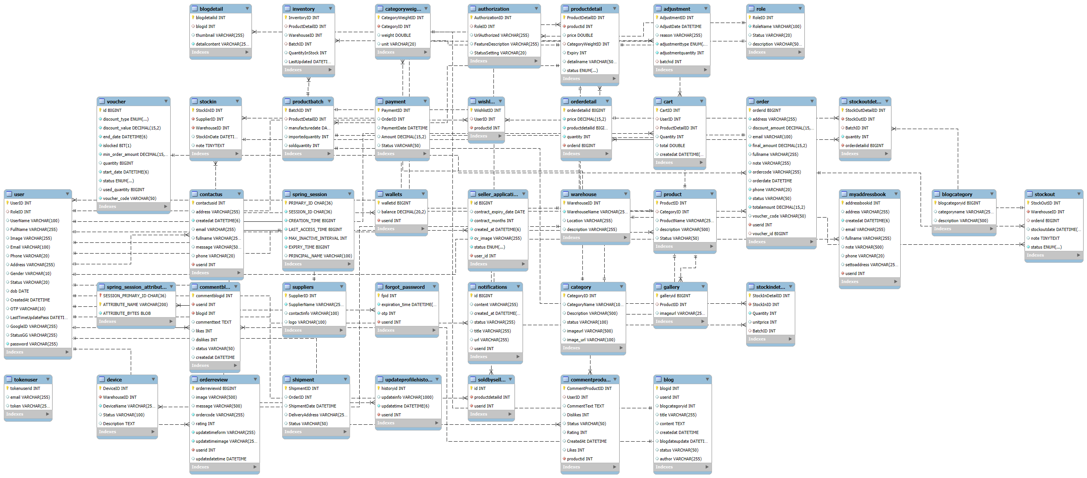
System Design
Database Design

Slide 20











Slide 21



